Slide 1
Time-dependent wind on Advection-Diffusion-Reaction system
Giuseppe Sacco

Slide 2
General ADR
The combined effect of advection, diffusion and reaction on a single-species population can give rise to very interesting behavior, especially when heterogeneities are introduced.
We will focus on the effect of a variable wind in a 2D environment with periodic boundary conditions and compare it with its constant wind counterpart.

Slide 3
General ADR
Advection-Diffusion-Reaction:
Advection reflects the transport of the population by its bulk motion;
Diffusion spreads the population across space;
Reaction represents the local growth (or decay) due to fertility of the environment.

Slide 4
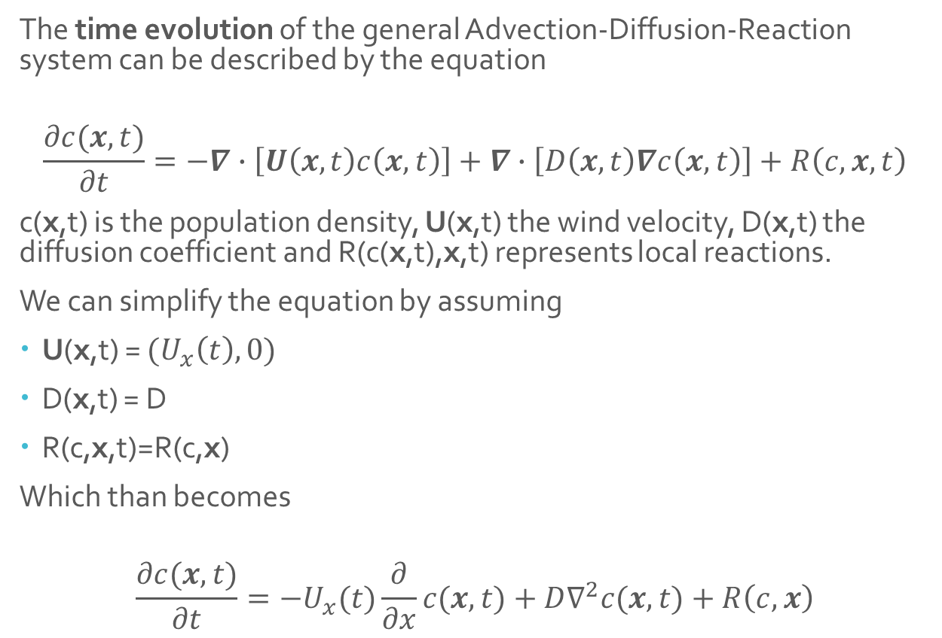
Continous ADR equation
The time evolution of the general Advection-Diffusion-Reaction system can be described by the equation
$$\frac{∂c(x,t)}{∂t}=−∇∙\left[U\left(x,t\right)c\left(x,t\right)\right]+∇∙\left[D\left(x,t\right)∇c\left(x,t\right)\right]+R\left(c,x,t\right)$$
c(x,t) is the population density, U(x,t) the wind velocity, D(x,t) the diffusion coefficient and R(c(x,t),x,t) represents local reactions.
We can simplify the equation by assuming
U(x,t) = ${(U}_{x}\left(t\right),0)$
D(x,t) = D
R(c,x,t)=R(c,x)
Which than becomes
$$\frac{∂c(x,t)}{∂t}=−U_{x}(t)\frac{∂}{∂x}c(x,t)+D∇^{2}c(x,t)+R\left(c,x\right)$$

Slide 5
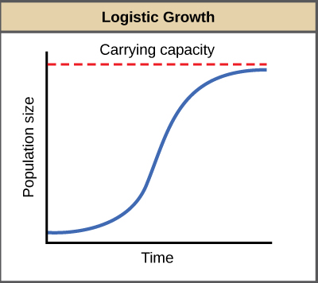
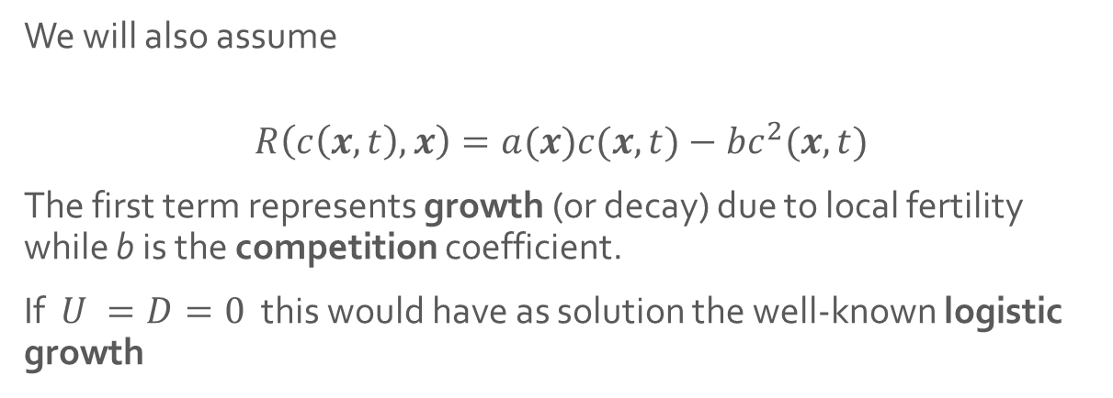
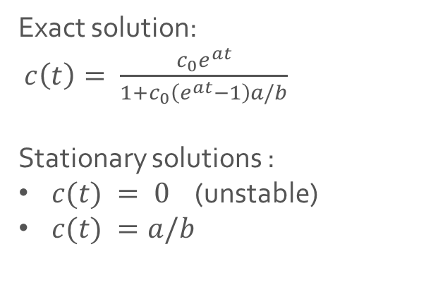
Local chemistry
We will also assume
$$R\left(c\left(x,t\right),x\right)=a(x)c(x,t)−bc^{2}(x,t)$$
The first term represents growth (or decay) due to local fertility while b is the competition coefficient.
If $U =D=0$ this would have as solution the well-known logistic growth
Exact solution:
$c\left(t\right)= \frac{c_{0}e^{at}}{1+c_{0}\left(e^{at}−1\right)a/b}$
Stationary solutions :
$c(t) = 0$ (unstable)
$c(t) =a/b$

Slide 6
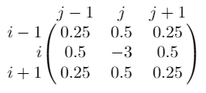
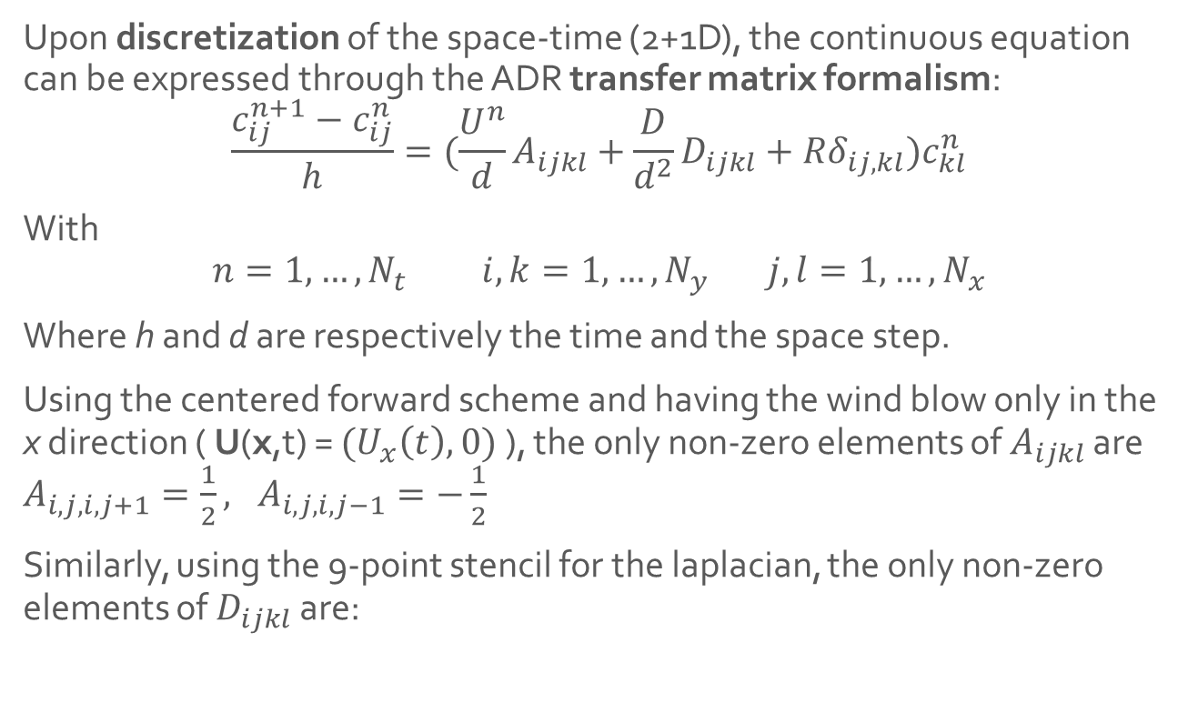
Discretization: the ADR transfer matrix formalism
Upon discretization of the space-time (2+1D), the continuous equation can be expressed through the ADR transfer matrix formalism:
$$\frac{c_{ij}^{n+1}−c_{ij}^{n}}{h}=(\frac{U^{n}}{d}A_{ijkl}+\frac{D}{d^{2}}D_{ijkl}+Rδ_{ij,kl})c_{kl}^{n}$$
With
$$n=1,…,N_{t} i,k=1,…,N_{y} j,l=1,…,N_{x}$$
Where h and d are respectively the time and the space step.
Using the centered forward scheme and having the wind blow only in the x direction ( U(x,t) = ${(U}_{x}\left(t\right),0)$ ), the only non-zero elements of $A_{ijkl}$ are $A_{i,j,i,j+1}=\frac{1}{2}, A_{i,j,i,j−1}=−\frac{1}{2}$
Similarly, using the 9-point stencil for the laplacian, the only non-zero elements of $D_{ijkl}$ are:
Lastly, since reaction acts locally, $δ_{ij,kl}$is the Dirac delta.

Slide 7
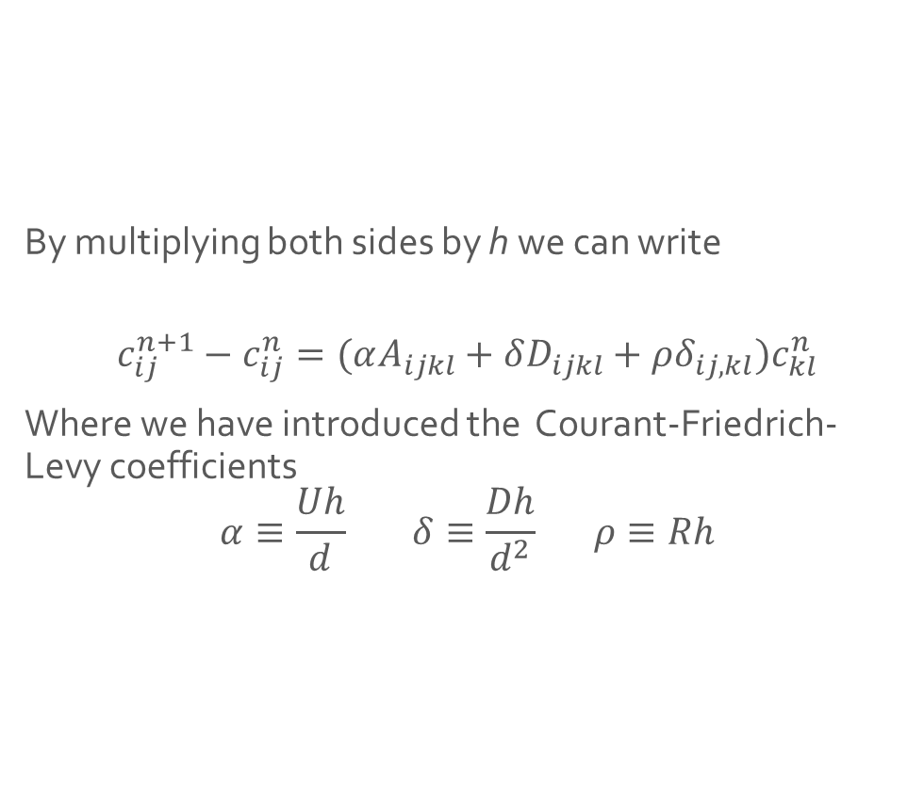
Discretization: the ADR transfer matrix formalism
By multiplying both sides by h we can write
$$c_{ij}^{n+1}−c_{ij}^{n}=(αA_{ijkl}+δD_{ijkl}+ρδ_{ij,kl})c_{kl}^{n}$$
Where we have introduced the Courant-Friedrich-Levy coefficients
$$α≡\frac{Uh}{d} δ≡\frac{Dh}{d^{2}} ρ≡Rh$$

Slide 8
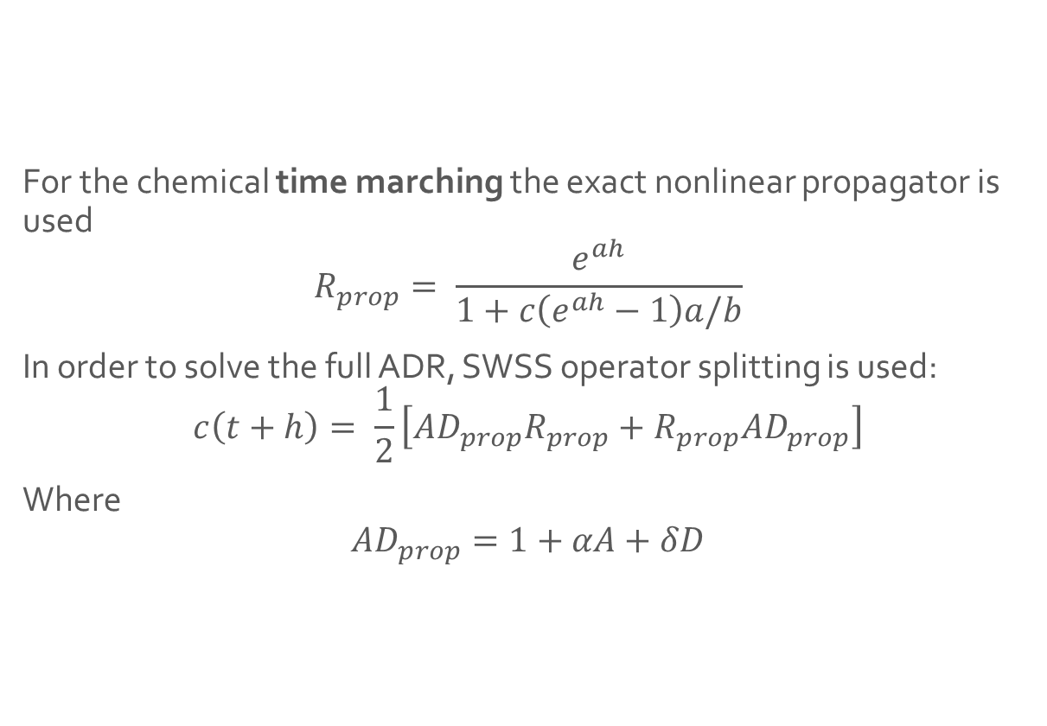
Propagators and time marching
For the chemical time marching the exact nonlinear propagator is used
$$R_{prop}= \frac{e^{ah}}{1+c\left(e^{ah}−1\right)a/b}$$
In order to solve the full ADR, SWSS operator splitting is used:
$$c\left(t+h\right)= \frac{1}{2}\left[{AD}_{prop}R_{prop}+R_{prop}{AD}_{prop}\right]$$
Where
$${AD}_{prop}=1+αA+δD$$

Slide 9
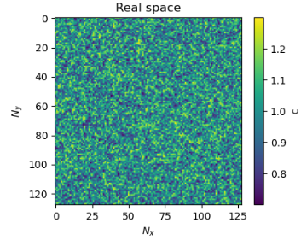
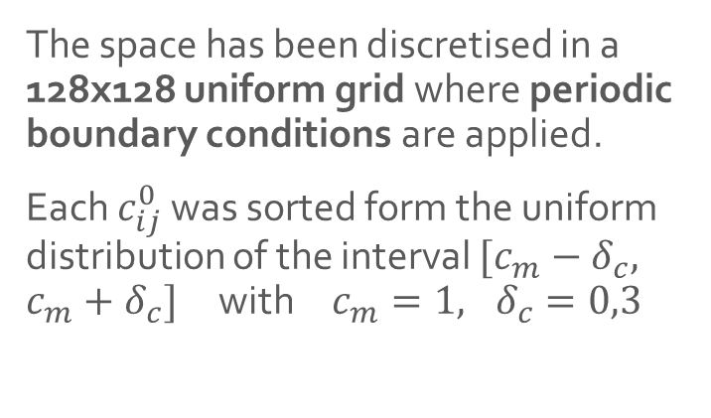
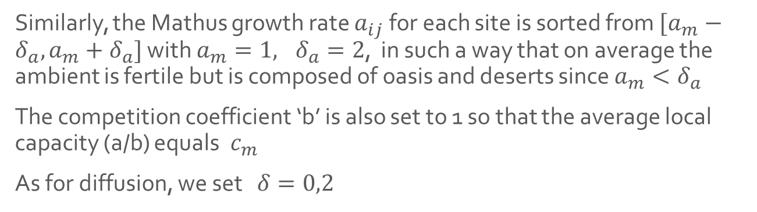
Simulation: initial conditions
The space has been discretised in a 128x128 uniform grid where periodic boundary conditions are applied.
Each $c_{ij}^{0}$ was sorted form the uniform distribution of the interval $[c_{m}−δ_{c}, c_{m}+δ_{c}]$ with$c_{m}=1, δ_{c}=0,3$
Similarly, the Mathus growth rate $a_{ij}$ for each site is sorted from $[a_{m}−δ_{a},a_{m}+δ_{a}]$ with $a_{m}=1, δ_{a}=2$, in such a way that on average the ambient is fertile but is composed of oasis and deserts since $a_{m}<δ_{a}$
The competition coefficient ‘b’ is also set to 1 so that the average local capacity (a/b) equals$c_{m}$
As for diffusion, we set $δ=0,2$

Slide 10
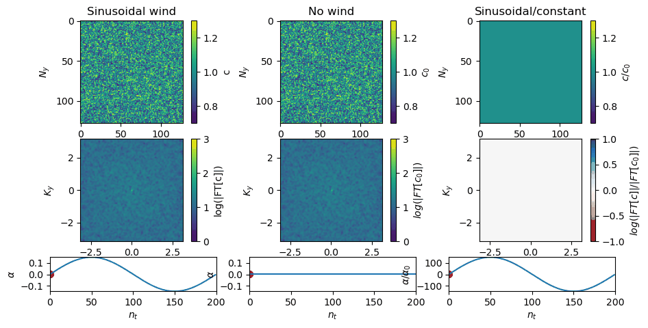
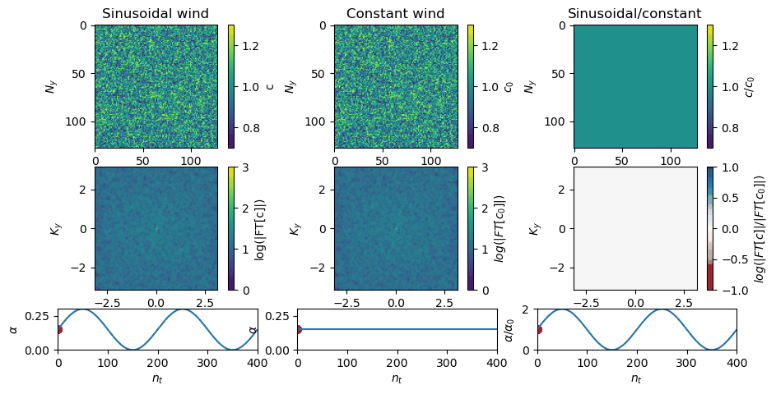
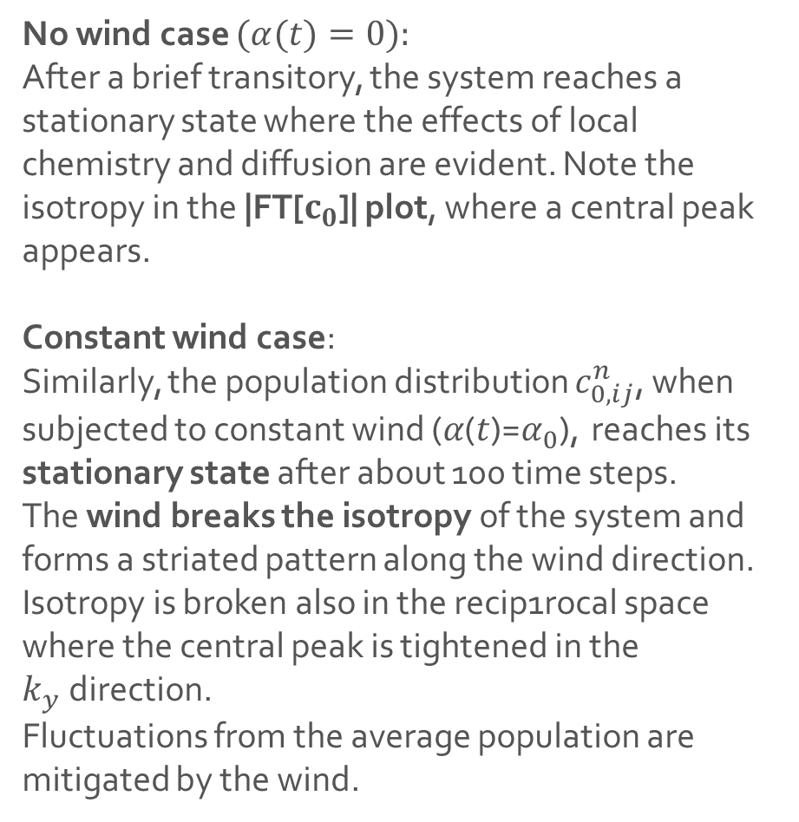
No-wind and Constant wind behaviour
No wind case $(α(t)=0):$
After a brief transitory, the system reaches a stationary state where the effects of local chemistry and diffusion are evident. Note the isotropy in the |FT[$c_{0}$]| plot, where a central peak appears.
Constant wind case:
Similarly, the population distribution $c_{0,ij}^{n}$, when subjected to constant wind (𝛼(𝑡)=$α_{0}$), reaches its stationary state after about 100 time steps.
The wind breaks the isotropy of the system and forms a striated pattern along the wind direction.
Isotropy is broken also in the recip1rocal space where the central peak is tightened in the $k_{y}$direction.
Fluctuations from the average population are mitigated by the wind.
(See Chotibut, Nelson, Succi, Physica A 2016)

Slide 11
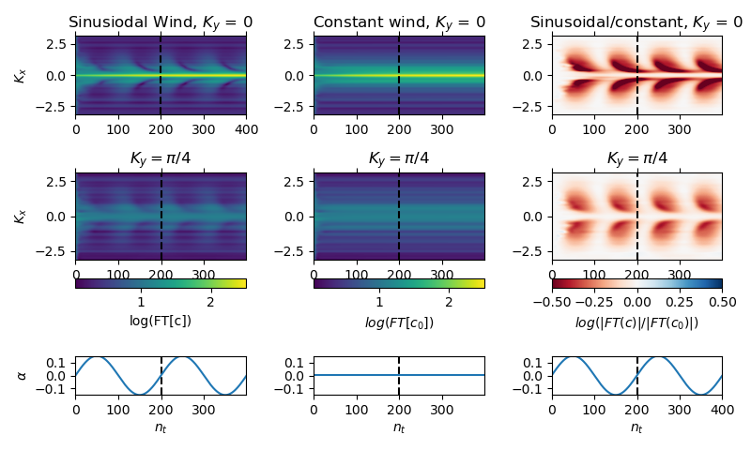
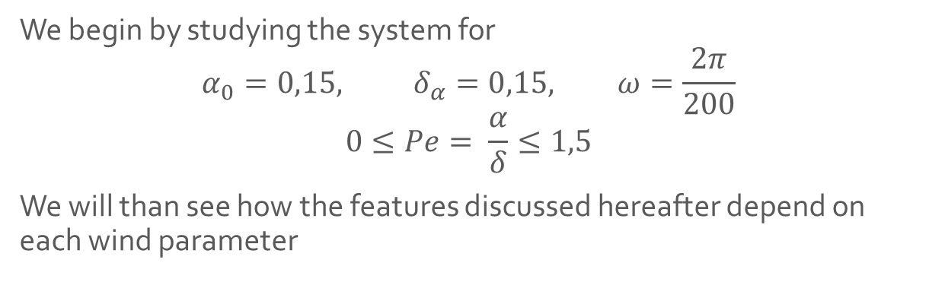
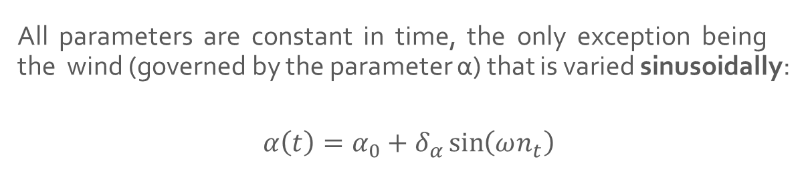
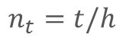
Sinusoidal wind
All parameters are constant in time, the only exception being the wind (governed by the parameter α) that is varied sinusoidally:
$$α\left(t\right)=α_{0}+δ_{α}\sin\left(ωn_{t}\right)$$
$$n_{t}=t/h$$
We begin by studying the system for
$$α_{0}=0,15, δ_{α}=0,15, ω=\frac{2π}{200}$$
$$0≤Pe= \frac{α}{δ}≤1,5$$
We will than see how the features discussed hereafter depend on each wind parameter

Slide 12

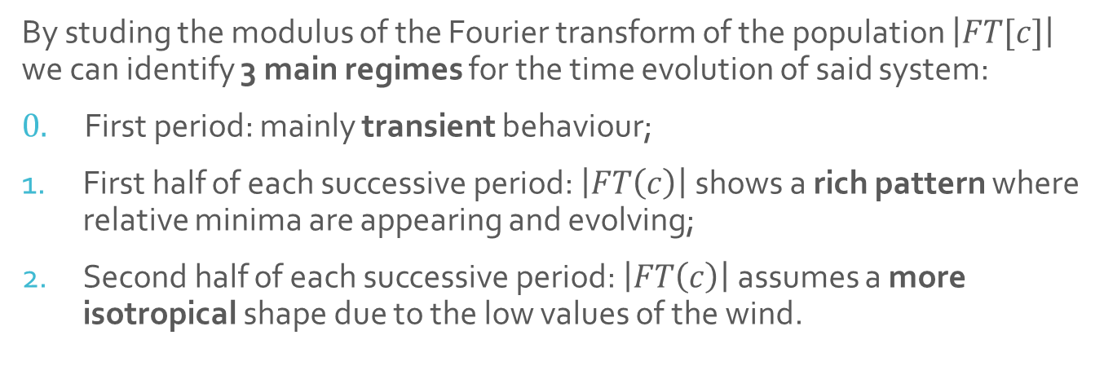
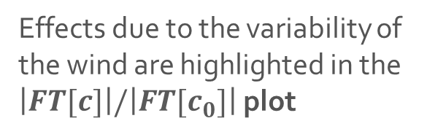
Simulation
By studing the modulus of the Fourier transform of the population $\left|FT[c]\right|$ we can identify 3 main regimes for the time evolution of said system:
$0.$First period: mainly transient behaviour;
First half of each successive period: $\left|FT\left(c\right)\right|$ shows a rich pattern where relative minima are appearing and evolving;
Second half of each successive period: $\left|FT\left(c\right)\right|$ assumes a more isotropical shape due to the low values of the wind.
Effects due to the variability of the wind are highlighted in the $\left|FT[c]\right|/\left|FT[c_{0}]\right|$ plot

Slide 13
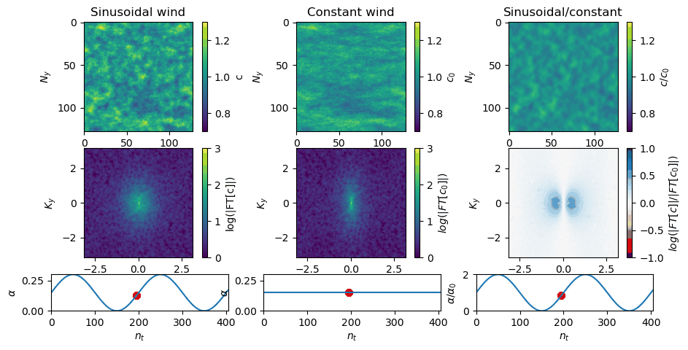
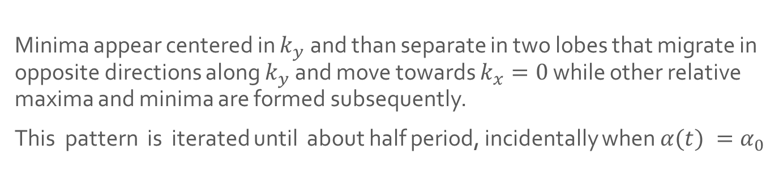
Evolution during phase 1
Minima appear centered in $k_{y}$ and than separate in two lobes that migrate in opposite directions along $k_{y}$ and move towards $k_{x}=0$ while other relative maxima and minima are formed subsequently.
This pattern is iterated until about half period, incidentally when $α(t) =α_{0}$

Slide 14
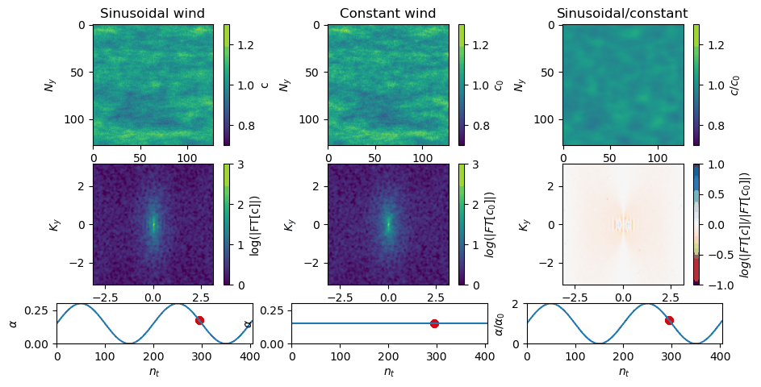
Evolution during phase 3
During the second half of the period the wind assumes low values and as a consequence |FT[c]| assumes a more isotropical shape.

Slide 15
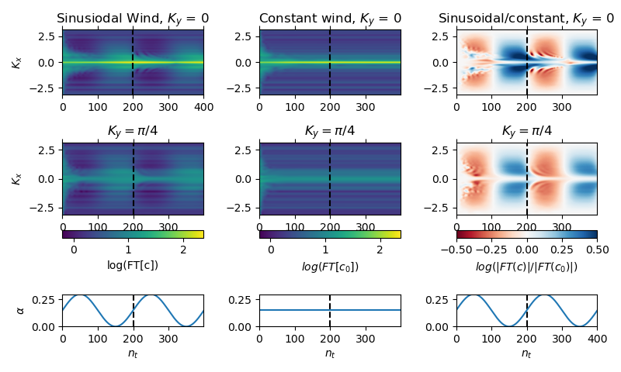
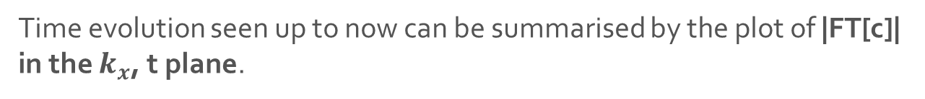

The $k_{x}$, t plane
Time evolution seen up to now can be summarised by the plot of |FT[c]| in the $k_{x}$, t plane.

Slide 16
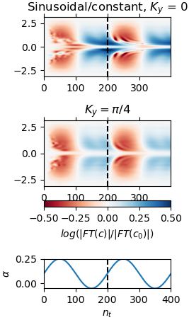
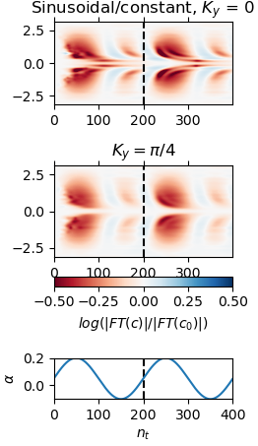
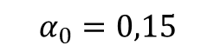
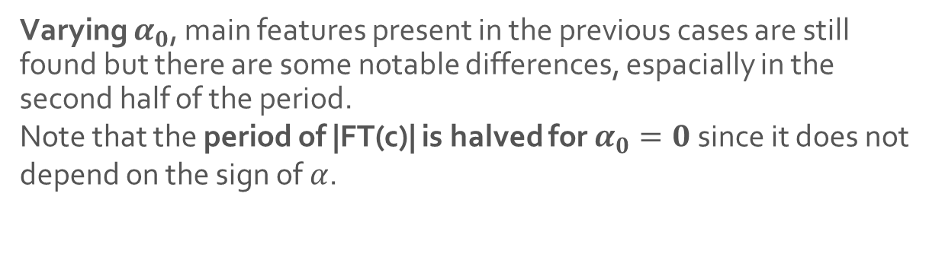


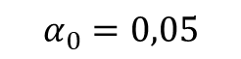
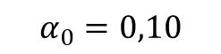
Dependance on wind parameters: $α_{0}$
Varying $α_{0}$, main features present in the previous cases are still found but there are some notable differences, espacially in the second half of the period.
Note that the period of |FT(c)| is halved for $α_{0}=0$since it does not depend on the sign of $α$.
$$α_{0}=0,15$$
$$α_{0}=0,10$$
$$α_{0}=0,05$$
$$α_{0}=0$$

Slide 17
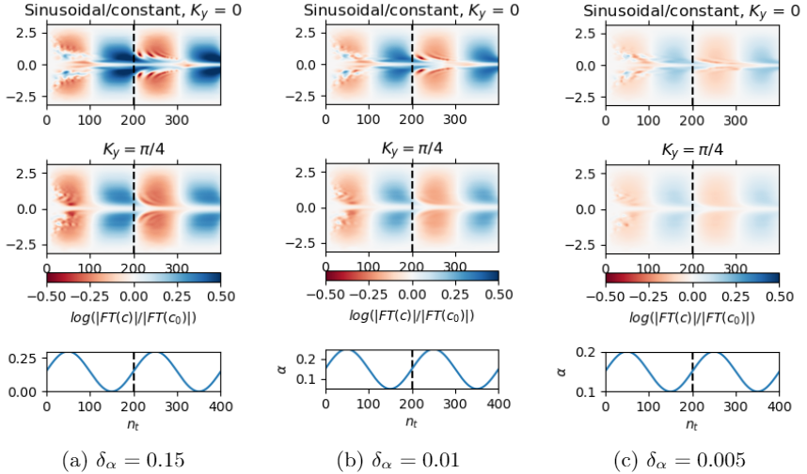
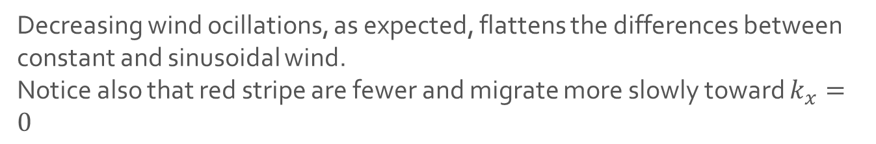

Dependance on $δ_{α}$
Decreasing wind ocillations, as expected, flattens the differences between constant and sinusoidal wind.
Notice also that red stripe are fewer and migrate more slowly toward $k_{x}=0$

Slide 18
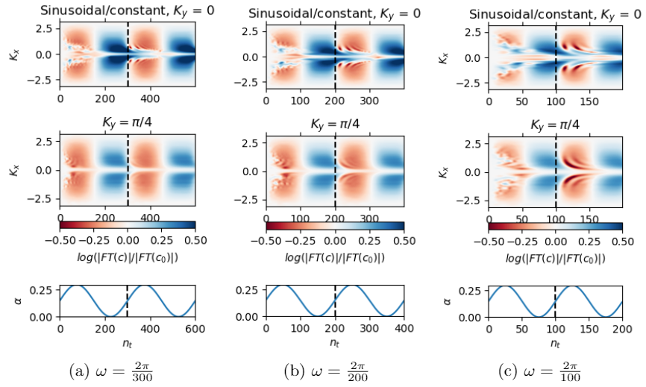

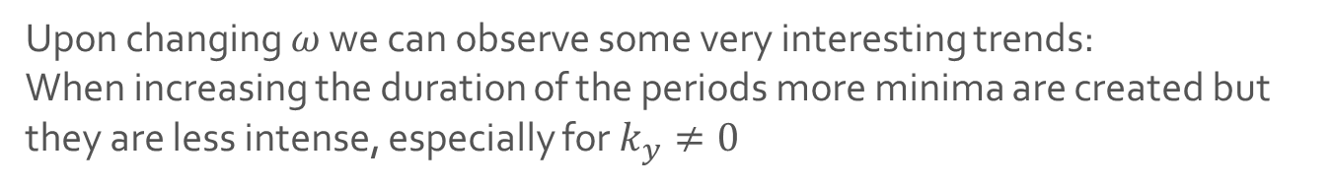
Dependance on $ω$
Upon changing $ω$ we can observe some very interesting trends:
When increasing the duration of the periods more minima are created but they are less intense, especially for $k_{y}≠0$

Slide 19
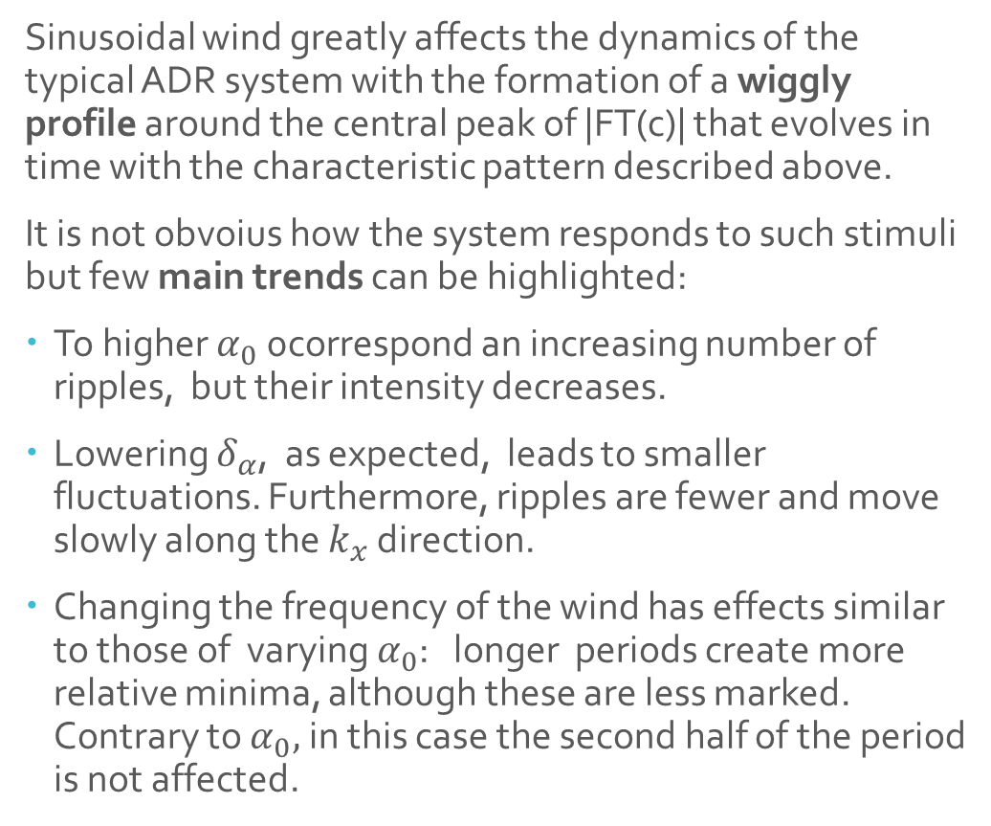
Conclusions
Sinusoidal wind greatly affects the dynamics of the typical ADR system with the formation of a wiggly profile around the central peak of |FT(c)| that evolves in time with the characteristic pattern described above.
It is not obvoius how the system responds to such stimuli but few main trends can be highlighted:
To higher $α_{0}$ 0correspond an increasing number of ripples, but their intensity decreases.
Lowering $δ_{α}$, as expected, leads to smaller fluctuations. Furthermore, ripples are fewer and move slowly along the $k_{x}$ direction.
Changing the frequency of the wind has effects similar to those of varying $α_{0}$: longer periods create more relative minima, although these are less marked. Contrary to $α_{0},$in this case the second half of the period is not affected.

Slide 20
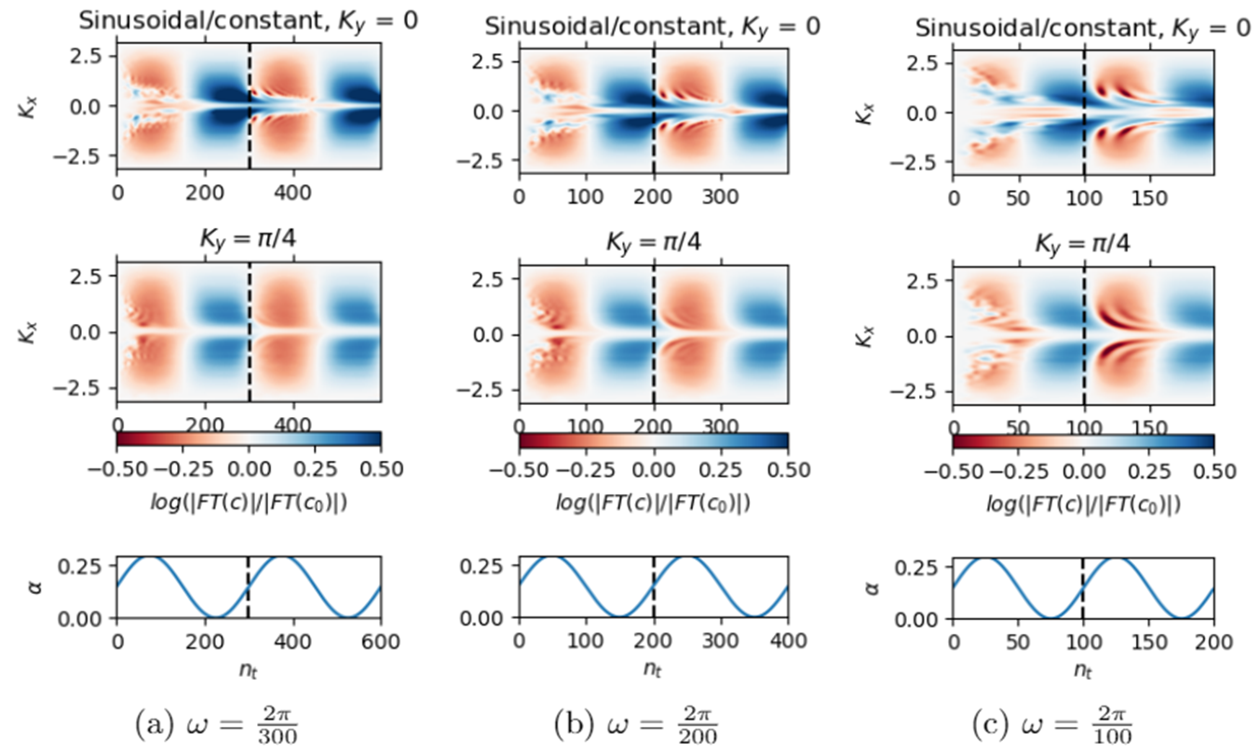
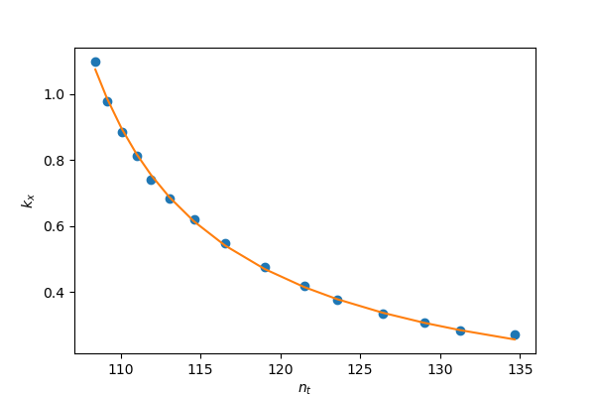
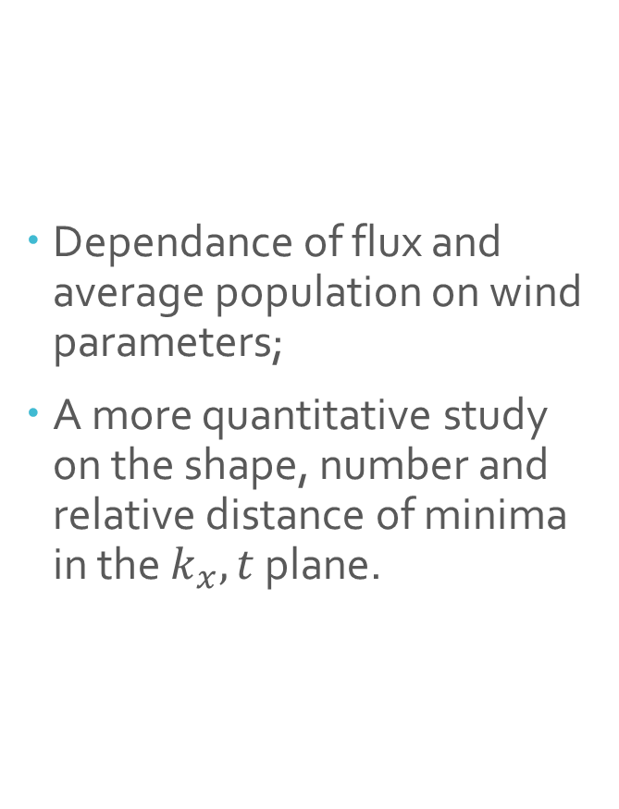
Possible future developments
Dependance of flux and average population on wind parameters;
A more quantitative study on the shape, number and relative distance of minima in the $k_{x},t$ plane.

